Slide 1
Capstone Engagement
Assessment, Analysis, and Hardening of a Vulnerable System

Slide 2
Table of Contents
This document contains the following sections:
01
Network Topology
02
Red Team: Security Assessment
03
Blue Team: Log Analysis and Attack Characterization
Hardening: Proposed Alarms and Mitigation Strategies
04

Slide 3
Network Topology
‹#›

Slide 4
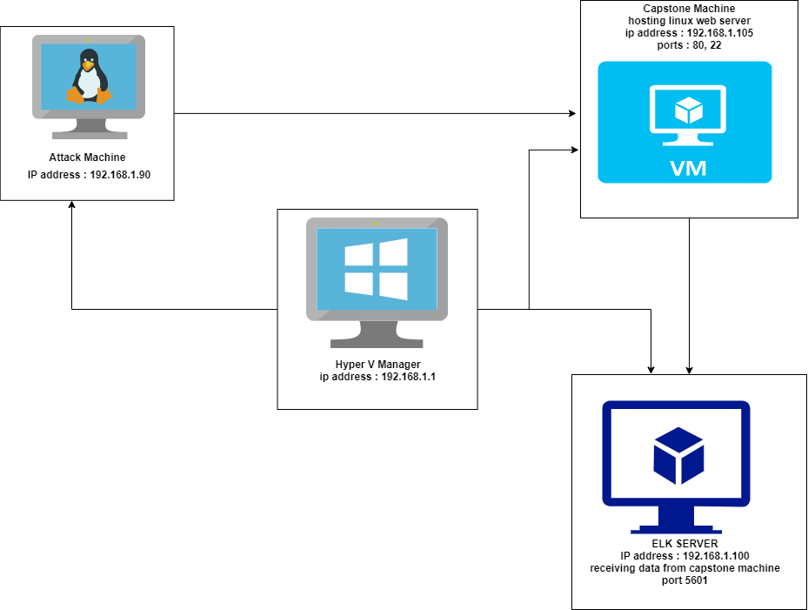
Network Topology
Network
Address Range: 192.168.1.0/24
Netmask: 255.255.255.0
Gateway: 192.168.1.1
Machines
IPv4: 192.168.1.1
OS: Windows
Hostname: HYPER V (ML-REFVM-684427)
IPv4: 192.168.1.105
OS: Linux
Hostname: Capstone
IPv4: 192.168.1.100
OS: Linux
Hostname: ELK
IPv4: 192.168.1.90
OS: Linux
Hostname: Kali

Slide 5

Red Team
Security Assessment
‹#›

Slide 6
Recon: Describing the Target
Nmap identified the following hosts on the network:
Hostname | IP Address | Role on Network
HYPER V MANAGER (ML-REFVM-684427) | 192.168.1.1 | GATEWAY/HYPERVISOR
CAPSTONE | 192.168.1.105 | TARGET MACHINE
ELK | 192.168.1.100 | ELK STACK SERVER
KALI | 192.168.1.90 | ATTACK MACHINE

Slide 7
Vulnerability Assessment
The assessment uncovered the following critical vulnerabilities in the target:
Vulnerability | Description | Impact
Brute Force Vulnerability | Password with simple words, and the lack of password complexity, such as the inclusion of symbols, numbers and capitals. | An attacker can launch a brute force attack using readily available dictionary (rockyou.txt) to guess a users password.
CWE-256: Unprotected Storage of Credentials | A password hash for a user was stored directly on a file within the server | An attacker can use readily available tools to crack this password and gain access to the system.
Information listed in a document on the web server give direct reference to a hidden directory with sensitive data. | A directory on the web server gave reference to a secret folder which wasn’t accessible to the public. The folder path was also listed. | With reference to a hidden directory, an attackers can focus attacks to access the contents of this directory
CWE-434: Unrestricted Upload of File with Dangerous Type. | Webdav was enabled on the web server allowing an attacker to upload malicious script directly to the web server. | WebDAV was not configured properly, so an attacker can remotely modify website content.

Slide 8
Exploitation: BRUTE FORCE VULNERABILITY
01
02
03
Tools & Processes
I used Hydra to brute force ashton’s password against the secret_folder directory after discovering he manages the directory.
hydra -l ashton -P /usr/share/wordlists/rockyou.txt -s 80 -vV 192.168.1.105 http-get /company_folders/secret_folder
Achievements
I uncovered his password which was “leopoldo”. I was then able to gain access to the secret folder with this password. Within the folder was instructions on how to connect to the companies Webdav server.
SEE SCREENSHOTS BELOW

Slide 9
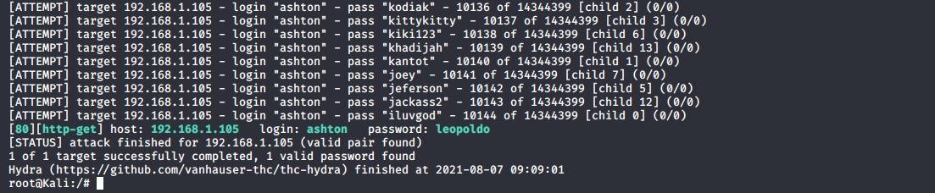
BRUTE FORCE VULNERABILITY
SCREENSHOTS
Ashton recon and password cracked.

Slide 10
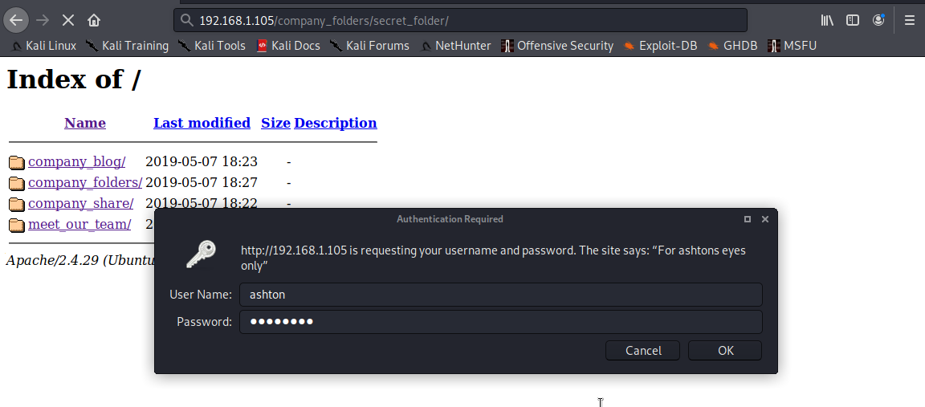
BRUTE FORCE VULNERABILITY
SCREEN SHOTS
LOGGING INTO SECRET FOLDER

Slide 11
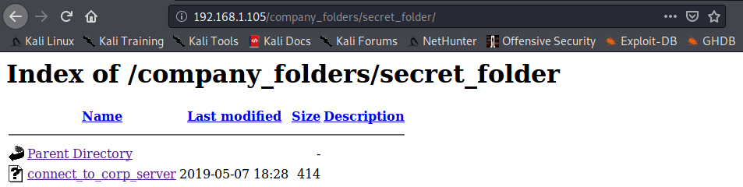
BRUTE FORCE VULNERABILITY
SCREEN SHOTS
ACCESS TO THE SECRET FOLDER DIRECTORY WITH

Slide 12
Exploitation: CWE-256: Unprotected Storage of Credentials
01
02
03
Tools & Processes
I discovered a password hash for Ryan which was stored in a file in the secret directory with further instructions on how to connect to the company’s webdav server. I was able to crack the hash with the website crackstation.net.
Achievements
I cracked the hash and gained access to the company’s webdav server with it.
SCREEN SHOTS BELOW.

Slide 13
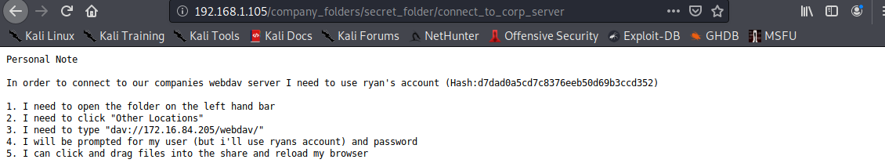
Exploitation: CWE-256: Unprotected Storage of Credentials
SCREEN SHOT
PASSWORD HASH LOCATED IN SECRET FOLDER AND INSTRUCTIONS TO CONNECT TO WEBDAV SERVER.

Slide 14
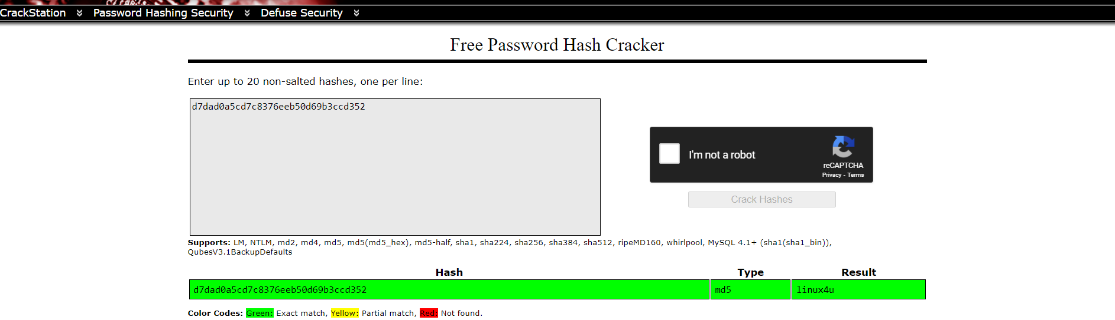
Exploitation: CWE-256: Unprotected Storage of Credentials
SCREEN SHOTS
PASSWORD HASH CRACKED

Slide 15
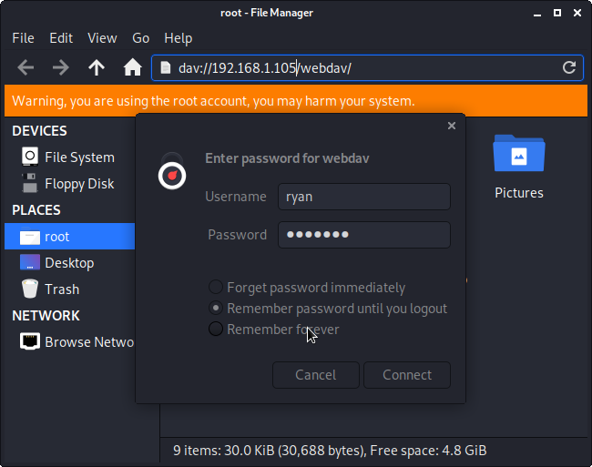
Exploitation: CWE-256: Unprotected Storage of Credentials
SCREEN SHOTS
WEBDAV LOGIN

Slide 16
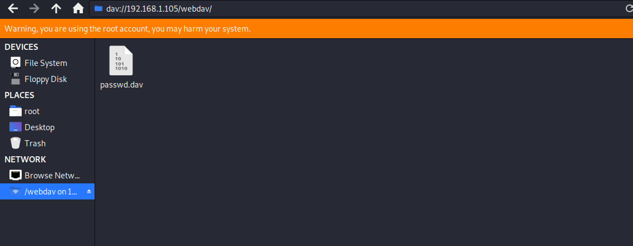
Exploitation: CWE-256: Unprotected Storage of Credentials
SCREEN SHOTS
Webdav access

Slide 17
Exploitation: CWE-434: Unrestricted Upload of File
01
02
03
Tools & Processes
After gaining access to the webdav server. I was able to use msfvenom to create a custom php reverse shell payload which i uploaded through the webdav server into the web server.
Achievements
I successfully upload a reverse php payload into the web server through webdav.
SCREEN SHOTS BELOW

Slide 18
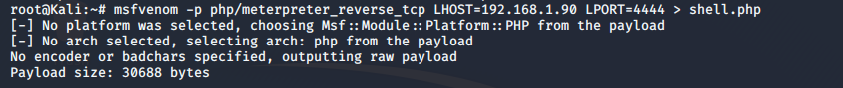
CWE-434: Unrestricted Upload of File with Dangerous Type.
SCREEN SHOTS
MSFVENOM PAYLOAD

Slide 19
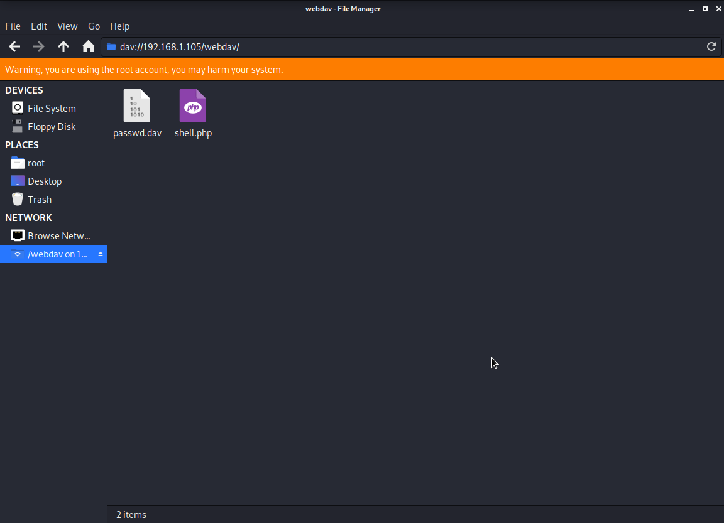
CWE-434: Unrestricted Upload of File with Dangerous Type.
SCREEN SHOTS
PAYLOAD UPLOADED TO WEBDAV SERVER

Slide 20
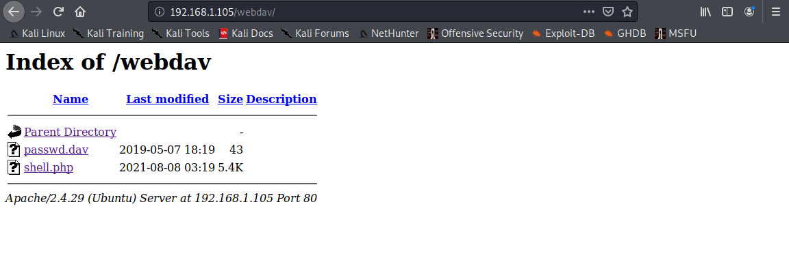
CWE-434: Unrestricted Upload of File with Dangerous Type.
SCREEN SHOT
PAYLOAD ON WEB SERVER

Slide 21

Blue Team
Log Analysis and Attack Characterization
‹#›

Slide 22

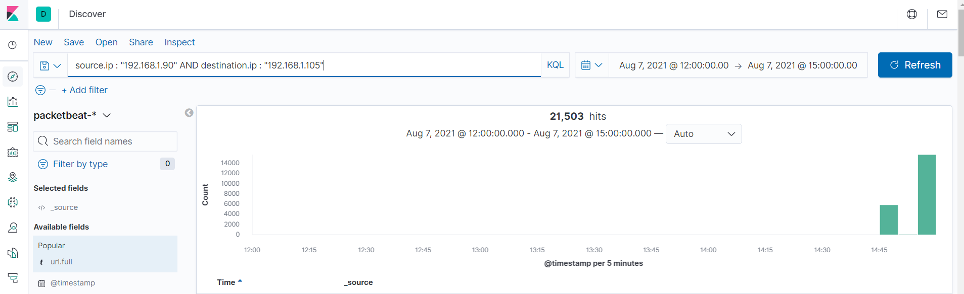
Analysis: Identifying the Port Scan
Answer the following questions in bullet points under the screenshot if space allows. Otherwise, add the answers to speaker notes.
What time did the port scan occur?
How many packets were sent, and from which IP?
What indicates that this was a port scan?

Slide 23
Analysis: Identifying the Port Scan
POINTS
The port scan occurred at 2021-08-07, 14:45. There was a total of 5,809 sent at 14.45 and 15,681 at 14.48 with a total of 21,503 packets transferred from IP Address : 192.168.1.90. The sharp rise in network traffic from that ip address would indicate this was a port scan.

Slide 24
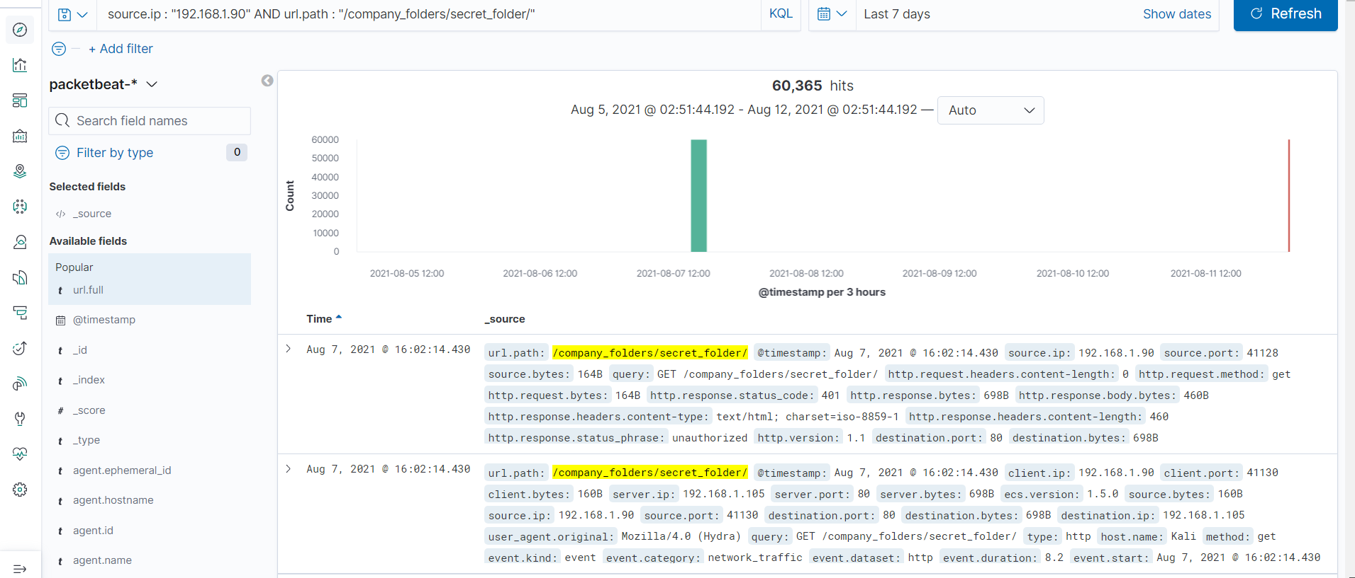
Analysis: Finding the Request for the Hidden Directory
Answer the following questions in bullet points under the screenshot if space allows. Otherwise, add the answers to speaker notes.
What time did the request occur? How many requests were made?
Which files were requested? What did they contain?

Slide 25
Analysis: Finding the Request for the Hidden Directory
NOTES
There was 60,365 HTTP requests for the company_folders/secret_folder directory originating from that single IP (192.168.1.90) at starting at 16:02 on 2021-08-07. The secret_folder directory contained a file with instructions on how to connect to the company’s webdav server and also a password hash for one of the company employees.

Slide 26
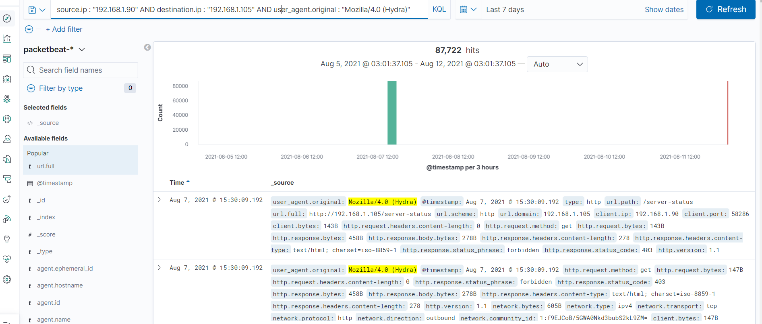
Analysis: Uncovering the Brute Force Attack
Answer the following questions in bullet points under the screenshot if space allows. Otherwise, add the answers to speaker notes.
How many requests were made in the attack?
How many requests had been made before the attacker discovered the password?
[Insert Here]
Include a screenshot of Kibana logs depicting the brute force attack.

Slide 27
Analysis: Uncovering the Brute Force Attack
NOTES
There was 87,722 request made by the brute force attack before the password was cracked.

Slide 28
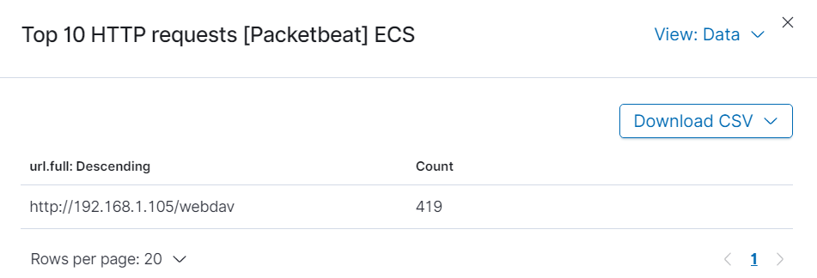
Analysis: Finding the WebDAV Connection
Answer the following questions in bullet points under the screenshot if space allows. Otherwise, add the answers to speaker notes.
How many requests were made to this directory?
Which files were requested?

Slide 29
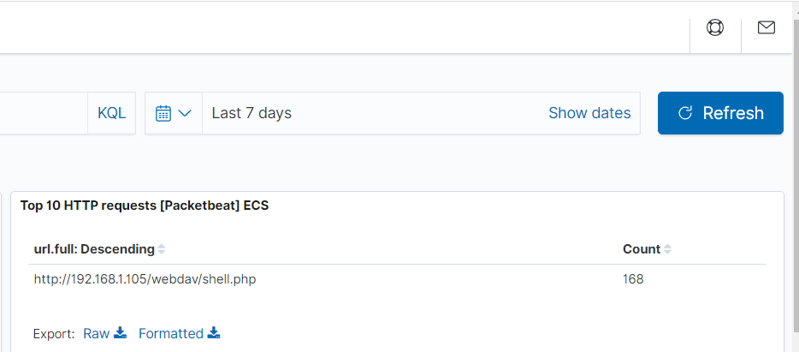
Analysis: Finding the WebDAV Connection
SCREEN SHOT
WEBDAV FILE REQUESTED

Slide 30
Analysis: Finding the WebDAV Connection
NOTES
There was a total of 419 request made to the Webdav directory and 168 requests to the file “shell.php” located within the webdav directory.

Slide 31
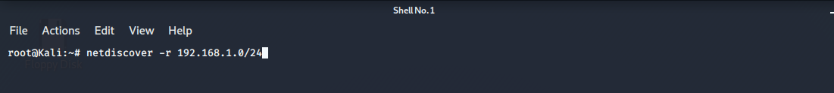
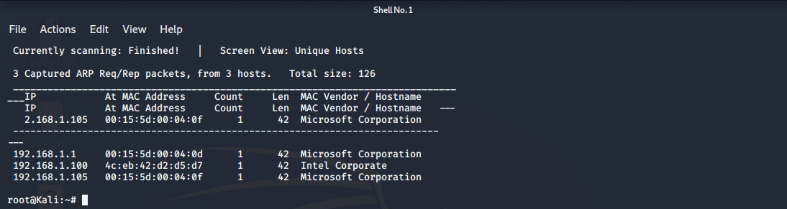
SOME OTHER SCREEN SHOTS
NET DISCOVER
SCANNING THE IP RANGE WITH NETDISCOVER

Slide 32
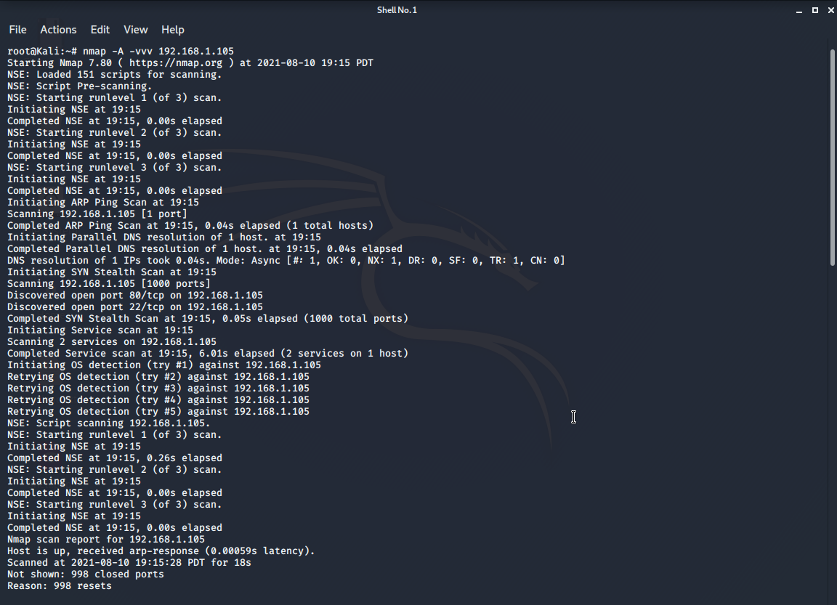
NMAP AGGRESSIVE SCAN RESULTS
USING NMAP TO GAIN KNOWLEDGE ABOUT THE WEB SERVER.

Slide 33
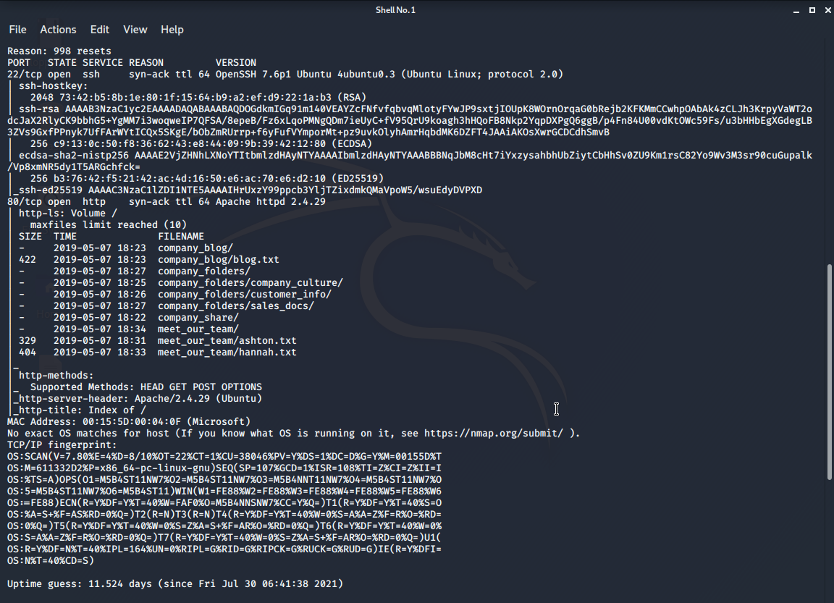
NMAP AGGRESSIVE SCAN RESULTS
USING NMAP TO GAIN KNOWLEDGE ABOUT THE WEB SERVER.

Slide 34
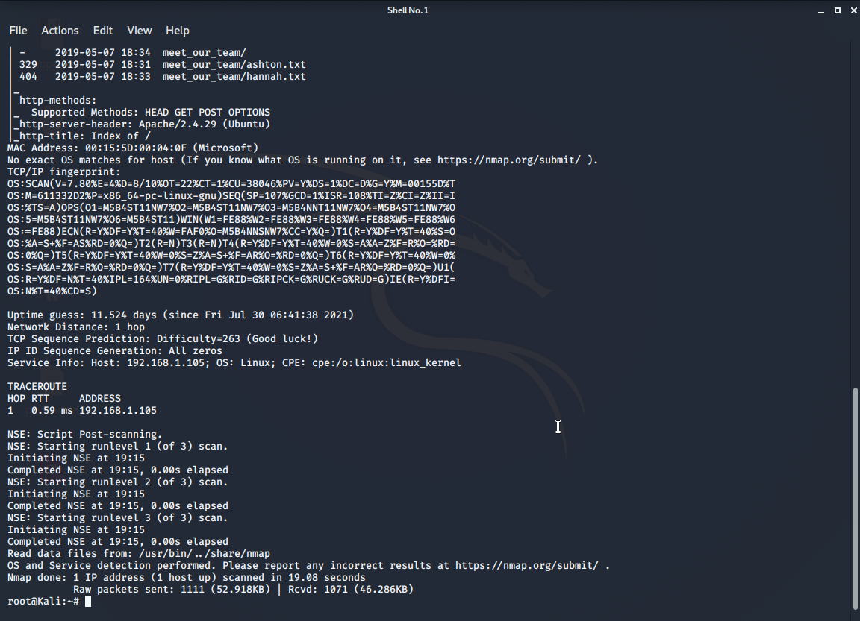
NMAP AGGRESSIVE SCAN RESULTS
USING NMAP TO GAIN KNOWLEDGE ABOUT THE WEB SERVER.

Slide 35
Blue Team
Proposed Alarms and Mitigation Strategies
‹#›

Slide 36
Mitigation: Blocking the Port Scan
I would set an alarm that triggers when there are more than 50 connections to any port within the network in an 30 minutes.
1. I would block all ports that are not in use within the network.
2. I would create a whitelist of known IP’s for ports in use and update the firewalls rules to block any scan or connections from IP not listed.
3. Regular system port scans of the opened ports to detect any vulnerabilities.
4. Regular update of services running on open ports to keep them up to date and deploy patches for an zero day vulnerabilities.

Slide 37
Mitigation: Finding the Request for the Hidden Directory
I would set an Alert to be triggered if there are more than 20 HTTP requests originating from a single IP address to hidden directories on the network.
Blacklisting any IP address that sends more than 20 HTTP requests to any hidden directory.
Encrypting data contained in hidden directories on the server
Removing public access to hidden directories and giving access to only internal or pre-defined IP addresses.

Slide 38
Mitigation: Preventing Brute Force Attacks
I would set an Alarm to be triggered when there are 5 failed login attempt to any directory or service running on the network or when a single IP returns a 401 error 5 times in a row.
Account lockout for 10 minutes after 5 failed login attempts.
Blacklist any IP address that triggers an account lockout twice in a row and disable the user account immediately.
A strong password policy for all staff and requirement that password be changed every 3 months.
Multi factor authentication for all employees.

Slide 39
Mitigation: Detecting the WebDAV Connection
I would create a whitelist of trusted IP addresses that can access the webdav directory and an alert for any other IP that tries to access it. I would also set an alert for any HTTP PUT request made to the webdav server regardless of the IP.
Whitelist of approved IP’s that can access the Webdav server.
Strong password for users who have access
Blocking access to the webdav directory from the public and allowing only internal access.
Regular update of the server to deploy patches for any vulnerabilities.

Slide 40
Mitigation: Identifying Reverse Shell Uploads
All uploads should be scanned by a strong anti malware software and an alert triggered if a suspicious code, script or file extension is detected.
Blocking any file uploads that contains a suspicious extension, code or script.
Requiring authentications to upload any file.
Having a list of approved files that can be upload to the webserver.
Storing uploaded files in a location not accessible from the web

